Slide 1


Smt. Kashibai Navale College of Engineering
Computer Department
BE Project Presentation On Bank Data Classification
PRESENTED BY: (GROUP 11) GUIDED BY:
JAIN AKHILESH 113 B150364320 DR. S. K. PATHAN
KABRA VENKATESH 114 B150364328
PATIL MRUNAL 130 B150364428
SONAWANE ADITI 143 B150364505

Slide 2
Motivation
All over the world, banking industry has a revenue of 315 Billion U.S Dollars and a growth rate of 8.8% making it a vital sector for the development of the economy.
The core of developing this financial sector is customer acquisition and retention.
The Banking industry generates a massive volume of data every day. Data analytics can be used to analyse large volume data to extract meaningful information from it.

Slide 3
Introduction
Naïve Bayes
Helping a Financial Institution to Predict the Potential Customers, Analyse Customer Satisfaction and build a Decision Support System to help Loan Approvals.
Analysing following algorithms and selecting the best one for Customer Acquisition, Retention and Loan Prediction respectively.
Thus improving Accuracy, developing a Scalable System for Predictive Analysis.
K Nearest Neighbour
Random Forest Classifier
Possible Classification Methods
ID 3
Logistic Regression
ANN Algorithm
48 Decision Trees
C 4.5 Algorithm
Fig: Classification Algorithms

Slide 4
Problem Statement
To develop a novel system for predicting the potential customers for the banking industry using C 4.5 Algorithm, Retention of Customers and Loan Prediction using Random Forest Algorithm.

Slide 5
Literature Survey
Paper/Article Name | Publishing House and year | Description
Classification Of A Bank Data Set On Various Data Mining Platforms | IEEE | In this paper, accuracy, precision and fmeasure criteria were used to test performances of the classification models.
Digitalisation and Big Data Mining in Banking | IEEE | In this paper, having summarized the recent applications, big data in banking have been exploited for improving customer satisfaction, marketing and optimizing strategic management. Specifically security and fraud detection, risk management and investment banking, customer relationship management (CRM) and other advanced supports.

Slide 6
Paper/Article Name | Publishing House and year | Description
Analysis of Banking Data Using Machine Learning. | IEEE | In this paper, they have summarised various algorithms of ML and how ANN can be used for customer retention and fraud detection in banking sector.
Fraud Detection in Banking Sector using Data mining. | IJSR | This paper provides an overview of the concept of Data Mining and different frauds in Banking.
An Exploratory Data Analysis for Loan Prediction Based on Nature of the Clients. | IJRTE | The aim of this paper is to find the nature of the client applying for the personal loan. An exploratory data analysis technique is used to deal with this problem.
Research on bank credit default prediction based on data mining algorithm. | The International Journal of Social Sciences and Humanities Invention | This paper established bank credit default prediction models using Random Forest, Logistic Regression and SVM classification algorithms and compared the classification effect. Results show that Random Forest algorithm is more suitable.

Slide 7
Gap Analysis
Criteria | Accuracy |  |  | Precision
Algorithms | NB | KNN | C4.5 | NB | KNN | C4.5
R | 0.87 | 0.87 | 0.906 | 0.93 | 0.91 | 0.92
Knime | 0.82 | 0.87 | 0.905 | 0.88 | 0.88 | 0.92
RapidMiner | 0.86 | 0.84 | 0.88 | 0.88 | 0.88 | 0.92
Weka | 0.88 | 0.86 | 0.90 | 0.93 | 0.91 | 0.937
Feature: Customer Acquisition

Slide 8
Gap Analysis
Paper Name | Algorithm | Efficiency
Analysis of Banking Data Using Machine Learning. | ANN | 72%
Techniques for customer retention- A comparative study. | Logistic Regression Random Forest KNN Naïve Bayes | 87% 96% 91% 88%
Feature: Customer Retention

Slide 9
Gap Analysis
Algorithm | Efficiency
Random Forest Classifier | 88.63%
Logistic Regression | 71.30%
SVC | 85.80%
Feature: Loan Prediction

Slide 10
Bank System Architecture
Banking System
Customer Acquisition
Loan Prediction
Customer Retention
Dataset
Attribute Selection
Training Data
Testing Data
Data Pre-processing
Decision Tree Algorithm
Customer Acquisition- C 4.5
Customer Retention & Loan Prediction- Random Forest
Predicted Result
Knowledge Base
Classifier

Slide 11
Bank System Architecture Datasets and Attributes
Customer Acquisition
Attributes:
Customer Retention
Attributes:
Loan Prediction
Attributes:
Age
Job
Marital Status
Education
Default
Housing
Loan
Contact
Day
Month
Duration
Campaign
Pdays
Previous
Poutcome
RowNumber
Surname
CreditScore
Gender
Age
Tenure
Balance
NumOfProducts
HasCrCard
IsActiveMember
EstimatedSalary
Exited
Loan_ID
Gender
Marital Status
Dependents
Education
Self_Employed
ApplicantIncome
CoapplicantIncome
LoanAmount
Loan_Amount_Term
Credit_History
Property_Area

Slide 12
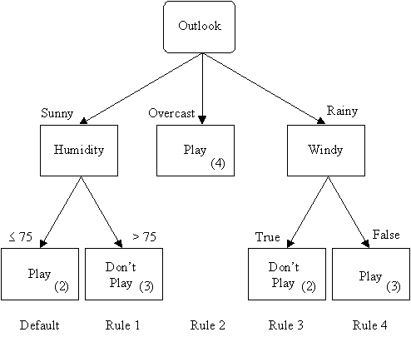
Bank System Architecture Algorithms
1. C 4.5
Feature: Customer Acquisition.
The C4.5 algorithm is used in Data Mining as a Decision Tree Classifier which can be employed to generate a decision, based on a certain sample of data.
C 4.5 is an algorithm developed by Ross Quinlan. It is an extension of Quinlan's earlier ID3 algorithm. As C4.5 can be used for classification, it is often referred to as a statistical classifier.
It works on the concept of information entropy. The training data is a set of classified samples having p-dimensional vectors defining the attributes of the sample.
C 4.5 generates a decision tree where each node splits the classes based on the gain of information. The attribute with the highest normalized information gain is used as the splitting criteria.
In this case, we are using it for predicting whether the customer is a potential customer or not by considering various attributes.
Fig: Example of C 4.5.

Slide 13
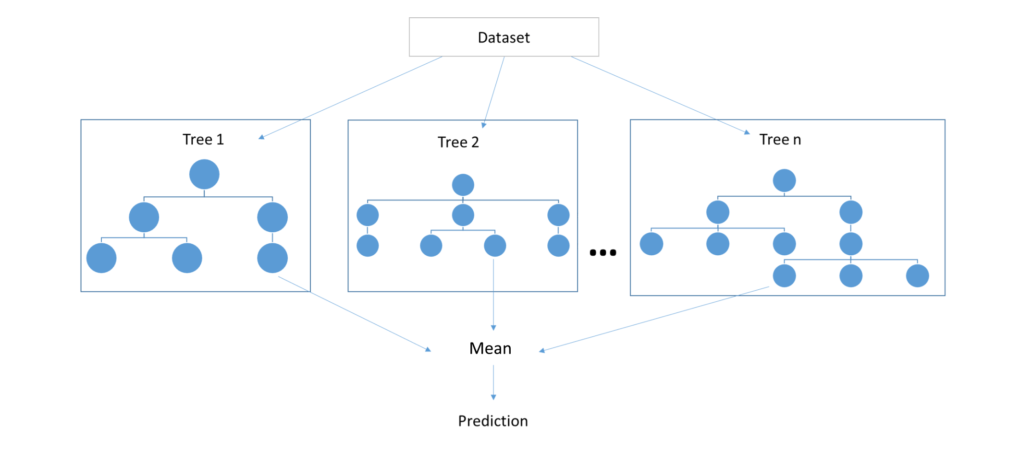
Bank System Architecture Algorithms
2. Random Forest
Feature: Customer Retention and Loan Prediction.
Random forests or random decision forests are an ensemble learning method for classification, regression and other tasks that operates by constructing a multitude of decision trees at training time and outputting the class that is the mode of the classes (classification) or mean prediction (regression) of the individual trees.
In particular, trees that are grown very deep tend to learn highly irregular patterns: they overfit their training sets. Random forests are a way of averaging multiple deep decision trees, trained on different parts of the same training set, with the goal of reducing the variance.
In this case, we are using Random Forest for determining whether the customer will discontinue his/her relationship with the bank.
The same can be used for predicting if the customer will be able to pay his loan within specified time considering attributes like credit score, property, etc.
Fig: Random Forest Working.

Slide 14
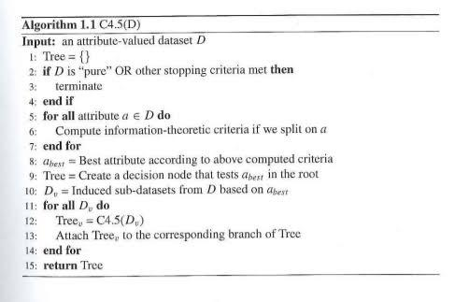
Pseudocode of C 4.5

Slide 15
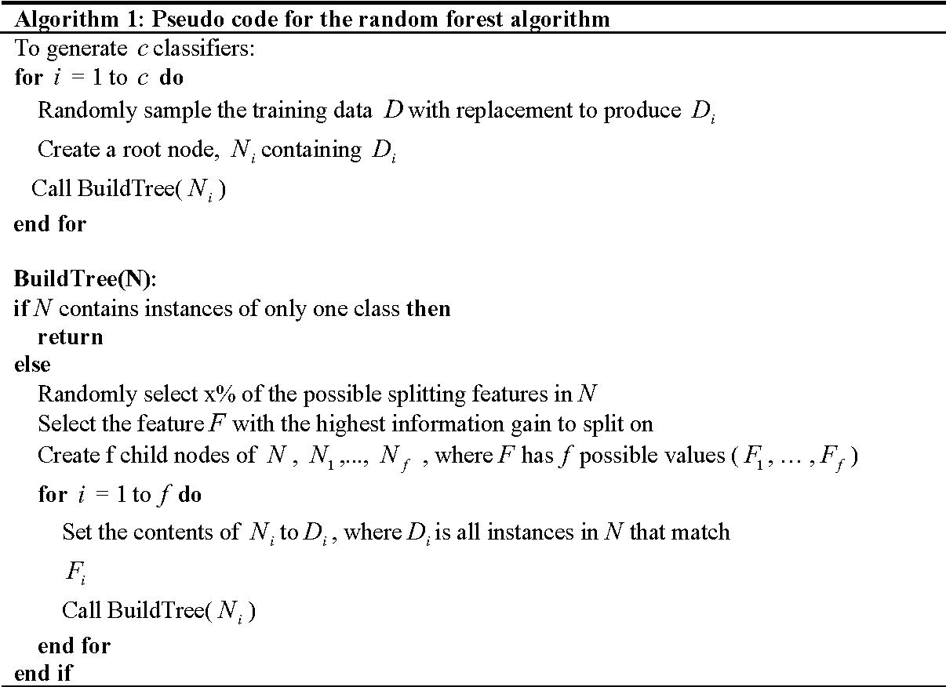
Pseudocode of Random Forest

Slide 16
Use Case Diagram
re
Registration
Log-In
Admin
Acquisition Prediction
Retention Prediction
Bank Employee
Banking System
Loan Prediction
View Generated Reports

Slide 17
Data Flow Diagram
Bank Data Classifier
fetch
Customer data
have
Customer
Customer Acquisition
Customer Retention
Loan Prediction
C4.5 Algorithm
Random Forest Algorithm
Result

Slide 18
ER Diagram
Call duration
Campaign
History
Branch_id
offers
Customer acquisition & retention
for
Contact
Job
Bank
Customer
Age
Branch_name
have
Loan Prediction
for
Marital Status
Credit score
Property
Dependents

Slide 19
Mathematical model
II1
I2
R1
R2
User
Result
Where,
I1: Data provided by user of one customer.
I2: Data provided as csv of many customers.
R1: Resultant class label predicted for one customer.
R2: Resultant class labels predicted for all the customers included in the csv file.

Slide 20
Mathematical model
Set Theory
S={Fu,I,O,F,S}
Fu={f1,f2,f3, f4, f5}
f1= Input Dataset
f2= Preprocess & Train Dataset
f3= Test Data for Acquisition
f4= Test Data for Retention
f5= Test Data for Loan Prediction
I= {I1, I2}
I1= {l1,l2…... ln} where n are the various attributes
I2= A .csv file containing multiple rows for batch processing
O={Acquisition:{positive, negative} Retention:{positive, negative} Loan:{positive, negative}}
F= 1. Huge database can lead to more time consumption to get the information.
2. Hardware failure & Software failure.
S= 1. Search the required information from available in Database.
2. User gets result very fast according to their needs.

Slide 21
System Requirements
Software Requirements:
Application Server: Django (WSGI)
Coding Language: Python
IDE: PyCharm
Dataset: Banking Dataset

Slide 22
Results
Easy Prediction of target customers.
Real time predictive analytics.
Planning of schemes.
Loan prediction.

Slide 23
Advantages
Faster and better identification of target audience:
By using C 4.5 classification algorithm, we identify the target set of customers.
Accuracy:
We get a very high accuracy of 90.6 percent by using C 4.5 for customer acquisition ,96 percent for Customer retention and 88.63 percent for Loan prediction.
Design Better Schemes:
Using the Random Forest Algorithm for Loan Prediction, better schemes can be designed.
Accelerate Business Decisions:
Business decisions can be improved significantly as the target audience can be known.

Slide 24
Limitations
Not always reliable.
Variation due to attributes.
Limited data set.

Slide 25
Conclusion
Data mining is a technique used to extract vital information from existing huge amount of data and enable better decision-making for the banking industries. The data is then analysed and the information that is captured is used throughout the organization to support decision-making. In banking field massive volume of data is continuously generating. This data can be used to extract meaningful information from it.
Data Mining techniques can help banking sector for better targeting and acquiring new customers, most valuable customer retention and loan prediction providing segment based products, analysis of the customers, transaction patterns over time for better retention and relationship, risk management and marketing.
Finally we conclude that Bank will obtain a massive profit if they implement data mining in their process of data and decisions.

Slide 26
Future Scope
Fraud Detection
Offering Personalized Services
Risk Management
Addressing Compliance Requirement

Slide 27
List of Publications
ICINC-2020
DSNCR-2020

Slide 28
References
Moro, P. Cortez, and P. Rita, “A data-driven approach to predict the success of bank telemarketing,” Decision Support Systems, vol. 62, s. 22-31, 2014.
S. Sumathi, S. Sivanandam, Introduction to Data Mining and Its Applications, Springer Science Business Media, 2006.
A.Keramati, R. JafariMarandi, M. Aliannejadi, I. Ahmadian, M. Mozaffari, and U. Abbasi, “Improved churn prediction in telecommunication industry using data techniques,” Applied Soft Computing, vol. 24, s. 994- 1012, 2014.
M.S. Bas¸arslan, F. Kayaalp, “Customer churn analysis with classification algorithms in telecommunication sector. ICAT’17, Istanbul, Turkey, 2017.
M.P.Bach, S. Jukovi c,K. Dumici, and N. Sarlija, “Business client segmentation in banking using self-organizing maps”, South East European Journal of Economics and Business, vol. 8,no. 2, s. 32-41, 2013.

